Slide 1

Floating Point Arithmetic: Representation
Computer Organization and Architecture | Computer Arithmetic
Course: Computer Organization and Architecture | Chapter: Computer Arithmetic | Program: Bachelor of Engineering
DISCOVER · LEARN · EMPOWER
Notes:
Welcome everyone to today's lecture on Computer Arithmetic. We will focus specifically on how computers represent and manipulate floating-point numbers. This is a foundational concept for understanding numerical precision in engineering applications. Remember, our motto is Discover, Learn, Empower, and today we empower you with the logic behind number representation.

Slide 2
Course Outcomes
SLIDE 2 / 10
Course Outcome
CO | BT LEVEL | DESCRIPTION
CO1 | BT3 | Apply number systems and digital logic to design basic digital circuits
CO2 | BT4 | Analyze register organization and instruction set architecture
CO3 | BT3 | Implement computer arithmetic algorithms and floating-point operations
CO4 | BT5 | Analyze memory hierarchy and input-output organization
CO5 | BT6 | Evaluate control unit design and pipelining performance
Chandigarh University
2 / 10
Notes:
Today's lecture directly addresses Course Outcome 3, which requires you to implement computer arithmetic algorithms. Specifically, you will learn the mechanics of floating-point operations essential for engineering calculations. By the end of this session, you will understand how to translate mathematical concepts into hardware-friendly representations. This skill is critical for designing efficient arithmetic logic units.

Slide 3
Learning Objectives
SLIDE 3 / 10
Learning Outcomes
1
Define the structure of IEEE 754 floating-point representation standards.
2
Analyze the role of sign, exponent, and mantissa in number encoding.
3
Calculate the decimal value from a given binary floating-point format.
4
Identify special cases like zero, infinity, and NaN in representation.
5
Evaluate the impact of precision and range on arithmetic accuracy.
Chandigarh University
3 / 10
Notes:
By the end of this lecture, you will be able to define the IEEE 754 standard and its components. You will analyze how the sign, exponent, and mantissa work together to encode numbers. We will practice calculating decimal values from binary formats to ensure you grasp the conversion process. Finally, we will evaluate how precision limits affect the accuracy of your engineering calculations.

Slide 4
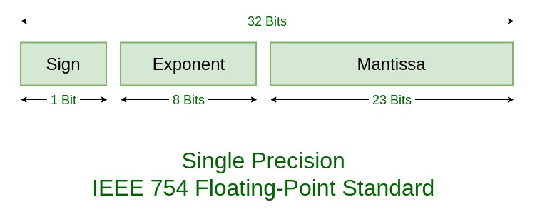
Lecture
SLIDE 4 / 10
Floating Point Representation Basics
THE FORMAT CONSISTS OF THREE FIELDS
sign bit, exponent, and significand.
• Floating-point numbers represent real numbers with a fractional part in binary.
• The value is calculated as sign × significand × 2^exponent.
• This format allows a wide dynamic range for very large and small numbers.
• It is the standard method for handling non-integer arithmetic in processors.
• Precision is determined by the number of bits allocated to the significand.
IEEE Standard 754 Floating Point Numbers - GeeksforGeeks
Chandigarh University
4 / 10
Notes:
Floating-point numbers allow us to represent real numbers with fractional parts in binary systems. The format is divided into three distinct fields: the sign bit, the exponent, and the significand. The mathematical value is derived by multiplying the sign by the significand and raising 2 to the power of the exponent. This structure enables processors to handle a vast dynamic range of values efficiently.

Slide 5
Lecture
SLIDE 5 / 10
IEEE 754 Single Precision Format
1
Single precision uses 32 bits total for standard floating-point representation.
2
The sign bit occupies the most significant bit (bit 31) of the format.
3
The exponent field uses 8 bits with a bias of 127 for storage.
4
The significand uses the remaining 23 bits with an implicit leading 1.
5
The actual exponent is the stored value minus the bias of 127.
6
This format balances range and precision for general-purpose computing tasks.
Source: media.geeksforgeeks.org
Chandigarh University
5 / 10
Notes:
The IEEE 754 standard defines single precision as a 32-bit format widely used in modern processors. The sign bit is the most significant bit, followed by an 8-bit exponent field. This exponent uses a bias of 127 to allow for both positive and negative exponents. The remaining 23 bits store the significand, which includes an implicit leading 1 to increase precision.

Slide 6
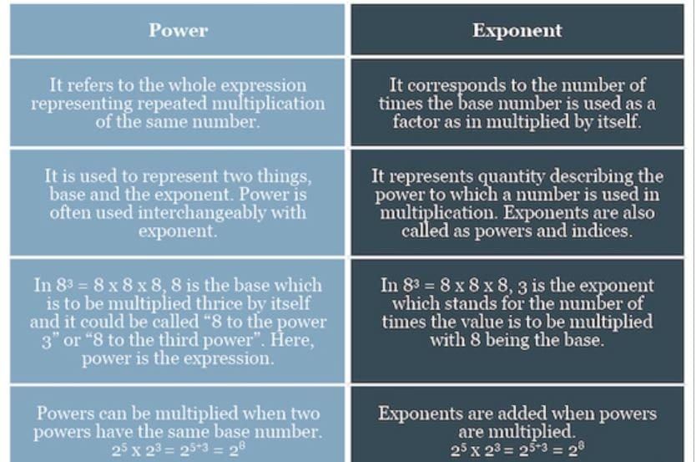
Lecture
SLIDE 6 / 10
Bias and Exponent Calculation
1
Exponents are stored as unsigned integers to simplify hardware comparison logic.
2
A bias of 127 is added to the actual exponent before storage.
3
To find the actual exponent, subtract 127 from the stored binary value.
4
For example, a stored exponent of 129 represents an actual value of 2.
5
This biasing technique avoids the need for separate sign bits in exponents.
6
The range of actual exponents for single precision is -126 to +127.
Source: prod.superblogcdn.com
Chandigarh University
6 / 10
Notes:
Exponents are stored as unsigned integers to simplify the hardware logic for comparison operations. We add a bias of 127 to the actual exponent before storing it in the register. To retrieve the actual value, you simply subtract 127 from the stored binary number. For instance, if the stored exponent is 129, the actual exponent is 2, calculated as 129 minus 127.

Slide 7
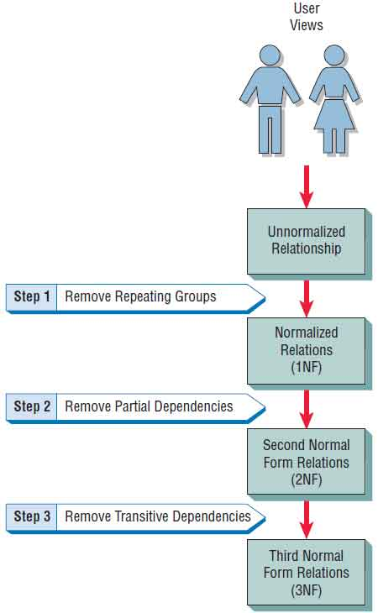
Worked Example
SLIDE 7 / 10
Decimal to Binary
1
Convert decimal 12.625 to IEEE 754 single precision binary format.
2
Integer part 12 converts to binary 1100, and fraction 0.625 converts to 0.101.
3
The combined binary is 1100.101, which normalizes to 1.100101 × 2^3.
4
The exponent 3 becomes 130 in binary (3 + 127 bias) after adding bias.
5
The significand stores the fractional part 100101 followed by zeros.
6
Final 32-bit pattern: 0 10000010 10010100000000000000000.
Source: www.w3computing.com
Chandigarh University
7 / 10
Notes:
Let us convert the decimal number 12.625 into IEEE 754 single precision format. The integer 12 is 1100 in binary, and the fraction 0.625 is 0.101, giving us 1100.101. We normalize this to 1.100101 × 2 to the power of 3. The exponent 3 plus the bias of 127 gives us 130, which is 10000010 in binary. The final 32-bit pattern combines the sign, biased exponent, and the fractional significand.

Slide 8
Lecture
SLIDE 8 / 10
Special Cases in Representation
1
Zero is represented when the exponent and significand are all zeros.
2
Infinity occurs when the exponent is all ones and the significand is zero.
3
NaN (Not a Number) appears when the exponent is all ones and significand is non-zero.
4
Denormalized numbers allow representation of values very close to zero.
5
These special cases handle edge conditions in arithmetic operations gracefully.
6
They prevent processor crashes during invalid mathematical operations like division by zero.
Chandigarh University
8 / 10
Notes:
The IEEE 754 standard defines special cases to handle edge conditions in arithmetic. Zero is represented when both the exponent and significand fields are all zeros. Infinity occurs when the exponent is all ones and the significand is zero. NaN, or Not a Number, appears when the exponent is all ones but the significand is non-zero, indicating an undefined result.

Slide 9
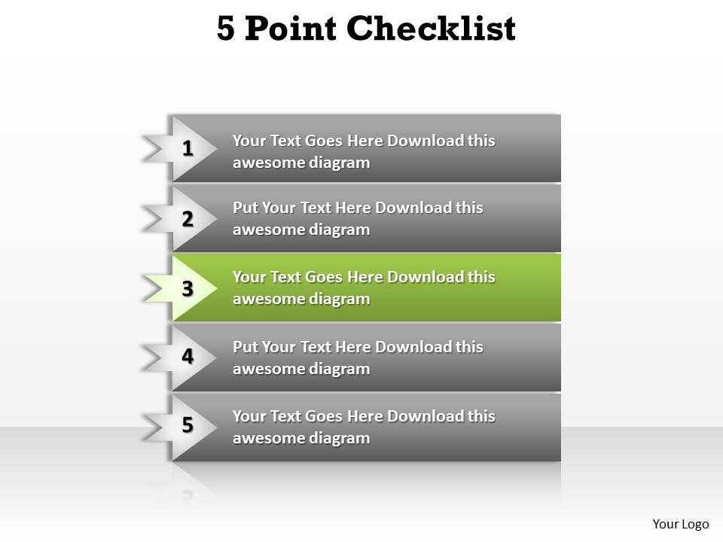
Lecture
SLIDE 9 / 10
Key Takeaways
1
Floating-point representation uses sign, exponent, and significand fields for real numbers.
2
IEEE 754 single precision uses 32 bits with a bias of 127 for exponents.
3
Normalization ensures a unique representation by shifting the binary point.
4
Special cases like Infinity and NaN handle undefined or extreme values.
5
Understanding this format is essential for implementing accurate arithmetic algorithms.
Source: www.slideteam.net
Chandigarh University
9 / 10
Notes:
To summarize, floating-point representation uses three fields to encode real numbers efficiently. The IEEE 754 standard uses a bias of 127 to store exponents in single precision. Normalization ensures that every number has a unique binary representation. We also covered special cases like Infinity and NaN for handling edge conditions. Mastering this format is essential for implementing accurate arithmetic algorithms in your future projects.

Slide 10
Lecture
SLIDE 10 / 10
References
COMPUTER ORGANIZATION AND DESIGN
The Hardware/Software Interface — David A. Patterson, John L. Hennessy
COMPUTER ARCHITECTURE
A Quantitative Approach — John L. Hennessy, David A. Patterson
• Computer Organization and Architecture — William Stallings
• Computer System Architecture — M. Morris Mano & Rajib Mall
• Computer Organization — Carl Hamacher, Zvonko Vranesic, Safwat Zaky
Chandigarh University
10 / 10
Notes:
The content of this lecture is based on standard texts in computer organization and architecture. Please refer to William Stallings for a comprehensive overview of computer organization. M. Morris Mano and Rajib Mall provide excellent insights into system architecture. The works by Hamacher, Vranesic, and Zaky, as well as Patterson and Hennessy, offer deep quantitative and design perspectives. These resources will support your further study of computer arithmetic.

